Slide 2

Module Objectives
Review the definitions of supervised and unsupervised learning
Introduce some popular unsupervised learning techniques
Learn about association rule mining and when it can be used
Learn how clustering techniques work and when they can be applied

Slide 3

Supervised vs. Unsupervised

Slide 4
Machine Learning Techniques
Regression
Predictive (Supervised Learning)
Classification
Machine Learning
Time Series
Association Rule
Descriptive (Unsupervised Learning)
Clustering

Slide 5
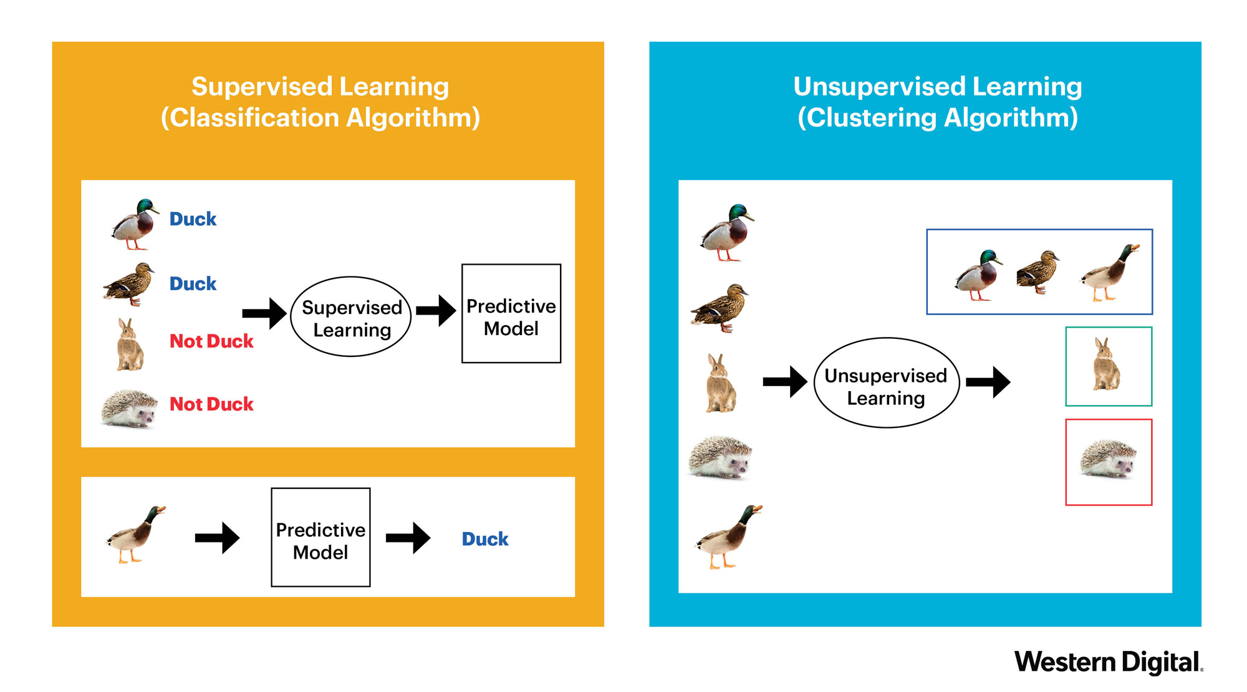
Supervised vs Unsupervised
Labelled Data
No Labelled Data

Slide 6
Unsupervised Learning
Unsupervised learning is the task of describing hidden structure from unlabeled data (no target variable)
Since the examples given to the “learner” are unlabeled, the error metric to be minimized must be defined in a general sense, across the group, instead of right/wrong answers.
The absence of an error or reward signal is the key difference between supervised and unsupervised learning.

Slide 7
Unsupervised Learning Techniques
Association Rules Mining
Clustering
Dimensionality Reduction

Slide 8
A.R.M.

Slide 9

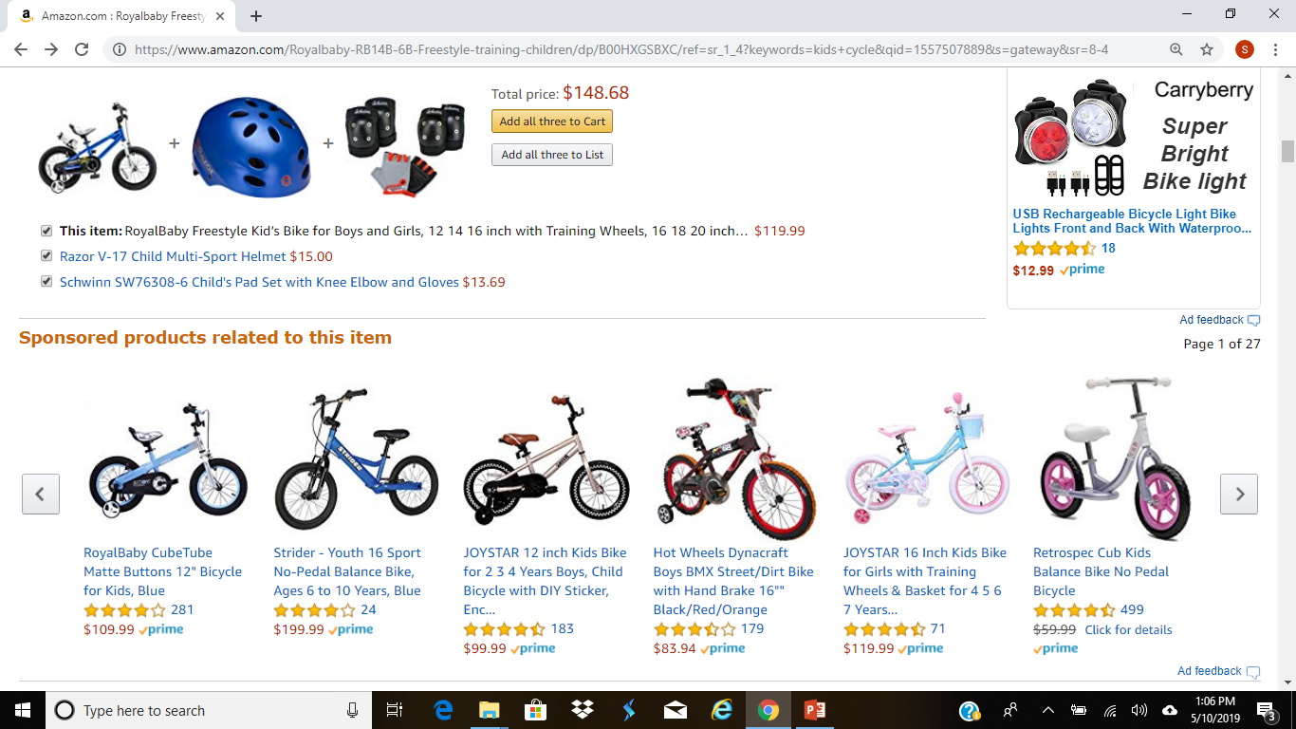
Association Rules Mining (ARM)
Association Rules Mining (ARM) is a rules based Machine Learning technique for discovering relationships between different items (or products) in a large dataset
Objective is not to predict the occurrence of an item, but to find usable, hidden patterns among the available items (or item sets) in a transactional dataset
The goal is to identify the co-occurrences of items/item sets with reasonable confidence
Notes:
Market basket analysis. - popular applications.

Slide 10
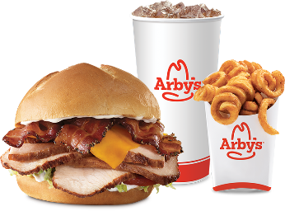

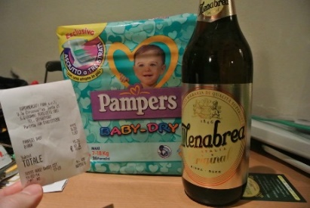

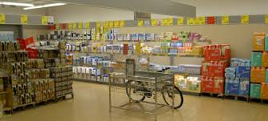
ARM Advantages
Obvious Ones:
Not so obvious
Prized discoveries
Business can profit from
Advantages
Bundle Pricing
Product placement
Shelf space optimization
Downside
May also lead to spurious relationships when dealing with data with billions of transactions
Notes:
Cross-seeling. Spurious relations: with millions of transactions, it is very common to find transactions with all kinds of possible and relationships. Nicotine patch and cigarettes, Curd and yogurt.
Businesses however need to careful by weighting the benift of suggesting an extremely relevant product against the risk of irritating customer who is already making a purchase
Determining a set of affinity products. Affinity: both product appear in the same transaction. Necessity in same time frame by large number of customers..

Slide 11
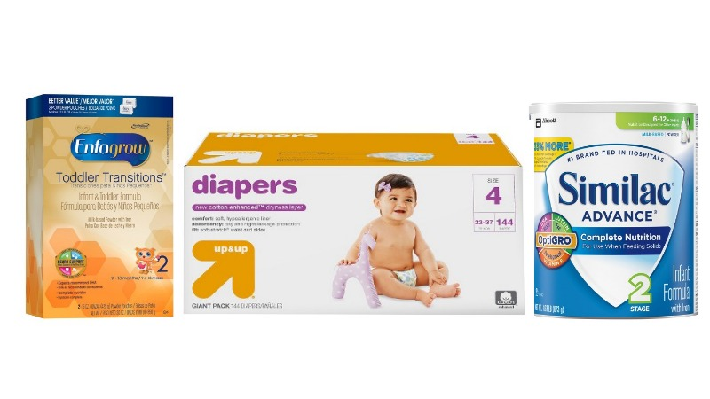
ARM Overview
Association Rule Mining is the task of finding frequent patterns, associations, correlations, or causal structures among sets of items or objects in a data set
Mathematically rooted in Bayes’ conditional probability theorem which calculates the likelihood that Event B will occur given that we’ve just witnessed Event A.
Primary focus is in generating rules such as
{Item A} -> {Item B} [support, confidence]
Ex: {Baby Formula} → {Diaper} [25, 50]
Important Terms:
Support = Do these things co-occur enough for me to care?
Confidence = Does Item A give me actionable information about Item B?
Notes:
Data Types
Categorical
Nominal (numeric)
Popular Technique
Bayesian Apriori

Slide 12
ARM Procedure & Challenges
Step 1: Prepare data in a particular format
Step 2: Short-list frequently occurring items (or items sets), based on some support level
Step 3: Generate relevant association rules from item sets generated in step 2 (based on some confidence parameters)
{Item A} -> {Item B} [Support, Confidence, Lift]
Item A – Antecedent or premise of a rule
Item B – Consequent or conclusion of a rule.
Main challenge for association rule analysis are
Computational time and resources
Ex: For association analysis of ‘n’ items, there will be
2^{n} -1 item sets, and 3^{n} – 2^{n} + 1 association rules can be found
Fortunately there are algorithmic approaches to efficiently find the frequent item sets and rules based on some parameters (support, confidence, lift)

Slide 13
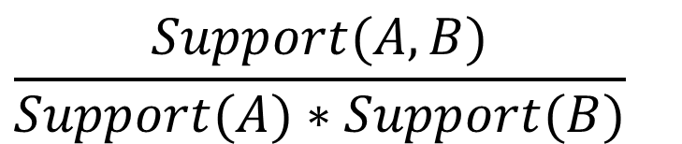
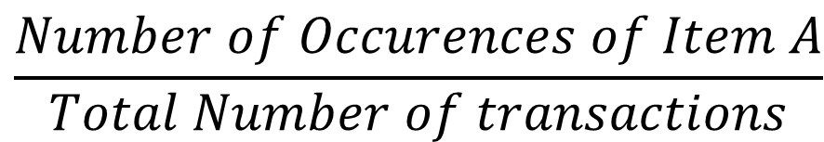
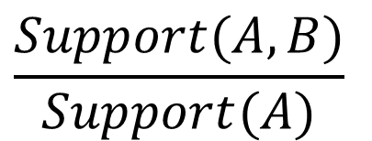
Support, Confidence, Lift
$$\frac{Number of Occurences of Item A}{Total Number of transactions}$$
Support (A) =
Confidence (A → B) =
Lift (A → B) =
$$\frac{Support(A,B)}{Support(A)}$$
$$\frac{Support(A,B)}{Support(A)∗Support(B)}$$
Notes:
Support:
The percentage of records in which both A & B appear
(# of records containing A & B ) / (Total # of Records)
Measures the relevance of a rule
“Do these things co-occur enough for me to care?”
Confidence:
The percentage of A records that contain B.
(# of A records containing B) / (Total # of A records)
Measures the reliability of a rule
“Does A give me actionable information about B?”

Slide 14
ARM Practical Example: Grocery Store
Step 1: Prepare data in a particular format
Step 2: Short-list frequently occurring items/item sets based on some support level
Step 3: Generate Rules

Slide 15
ARM: Grocery store
Rule Significance

Slide 16
Terminology
Why Use Support?
Removes rules with low potential business relevance.
Support can make association rule discovery more efficient.
Why Use Confidence?
Indicates which items in a set have higher information value.
Can be used to estimate the business impact of a rule.
Measures the probability of Item B occurring because Item A has occurred.
Why Use Lift?
Measures the importance of a rule
Rules greater than 1 imply greater significance
To check if Item A really has a positive effect in the occurrence of Item B

Slide 17
Apriori Algorithm
Frequent itemset generation can become complex as the number of items in a database grows.
The apriori algorithm helps manage this complexity.
Apriori Principle:
If an itemset is frequent, then its subsets must also be frequent.
If an itemset is infrequent, then all of its supersets must be infrequent as well.
The support of an itemset < the support of its subsets.
Notes:
Item set is frequent, means its support is more than the threshold choosen.

Slide 18
Apriori Steps
Apriori uses a breadth-first search process.
Apriori uses a "bottom up" approach, where frequent subsets are extended one item at a time.
The apriori algorithm has 2 steps:
Item set generation (breadth-first)
Association rule generation

Slide 19
Apriori: Step 1
Customer ID | Items Purchased
5279 | A, B, C
2980 | A, C
6314 | A, D
9065 | B, E, F
1142 | C, A, D, E
Item Set | Support
{A} | (4/5) = 80%
{B} | (2/5) = 40%
{C} | (3/5) = 60%
{D} | (2/5) = 40%
{E} | (2/5) = 40%
{F} | (1/5) = 20%
{A,B} | (1/5) = 20%
{A,C} | (3/5) = 60%
{A,D} | (2/5) = 40%
{A,E} | (1/5) = 20%
{A,F} | (0/5) = 0%
Min. Support = 50%
Min. Confidence = 60%

Slide 20
Apriori: Step 1
Customer ID | Items Purchased
5279 | A, B, C
2980 | A, C
6314 | A, D
9065 | B, E, F
1142 | C, A, D, E
Item Set | Support
{A} | (4/5) = 80%
{B} | (2/5) = 40%
{C} | (3/5) = 60%
{D} | (2/5) = 40%
{E} | (2/5) = 40%
{F} | (1/5) = 20%
{A,B} | (1/5) = 20%
{A,C} | (3/5) = 60%
{A,D} | (2/5) = 40%
{A,E} | (1/5) = 20%
{A,F} | (0/5) = 0%
Min. Support = 50%
Min. Confidence = 60%

Slide 21
Apriori: Step 2
Customer ID | Items Purchased
5279 | A, B, C
2980 | A, C
6314 | A, D
9065 | B, E, F
1142 | C, A, D, E
Item Set | Support
{A} | (4/5) = 80%
{A,C} | (3/5) = 60%
Rule | Confidence
A => B | (1/4) = 25%
A => C | (3/4) = 75%
A => D | (2/4) = 50%
A => E | (1/4) = 25%
A => F | (0/4) = 0%
C => A | (3/3) = 100%
C => B | (1/3) = 33%
Min. Support = 50%
Min. Confidence = 60%

Slide 22
Apriori: Step 2
Customer ID | Items Purchased
5279 | A, B, C
2980 | A, C
6314 | A, D
9065 | B, E, F
1142 | C, A, D, E
Item Set | Support
{A} | (4/5) = 80%
{A,C} | (3/5) = 60%
Rule | Confidence
A => B | (1/4) = 25%
A => C | (3/4) = 75%
A => D | (2/4) = 50%
A => E | (1/4) = 25%
A => F | (0/4) = 0%
C => A | (3/3) = 100%
C => B | (1/3) = 33%
Min. Support = 50%
Min. Confidence = 60%
Notes:
Same thing with the rules. If an itemset is infrequent, first of all it will not at all appear in the rules.
Also if a rule is low confidence, then all the rules with a subset of the antecedents of the rule will be low confidence as well.

Slide 23
Apriori: Step 2
Customer ID | Items Purchased
5279 | A, B, C
2980 | A, C
6314 | A, D
9065 | B, E, F
1142 | C, A, D, E
Item Set | Support
{A} | (4/5) = 80%
{A,C} | (3/5) = 60%
Rule | Confidence
A => C | (3/4) = 75%
C => A | (3/3) = 100%
Min. Support = 50%
Min. Confidence = 60%
Association Rule
“Body” => “Head” [support, confidence]
A => C [60%, 75%]
C => A [60%, 100%]

Slide 24
Apriori Principle
Item Set | Support
{A} | (4/5) = 80%
{B} | (2/5) = 40%
{C} | (3/5) = 60%
{D} | (2/5) = 40%
{E} | (2/5) = 40%
{F} | (1/5) = 20%
{A,B} | (1/5) = 20%
{A,C} | (3/5) = 60%
{A,D} | (2/5) = 40%
{A,E} | (2/5) = 20%
{A,F} | (0/5) = 0%
Apriori Principle:
If an itemset is frequent, then its subsets must also be frequent.
If an item set is infrequent, then all its supersets will also be infrequent
The support of an itemset < the support of its subsets.

Slide 25
Click-Stream Data Example
Support threshold = 0.25
Source: Predictive Analytics & Data Mining - Kotu
Notes:
One visit for a website in a session is a transaction. Categories visited on the website for a particular session could be items (sports, finance, religion etc..).
Goal is to find the associations between media categories.

Slide 26
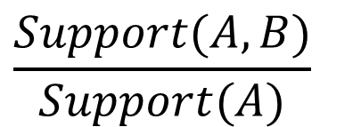
Click-Stream Data Example
Association Rules
Confidence threshold = 0.60
$$\frac{Support(A,B)}{Support(A)}$$
Confidence (A → B) =

Slide 27
A.R.M. Practical Examples
Use Cases:
Coupon printing at grocery store checkouts
Remarketing ad content selection
Drip marketing audience & campaign strategy
“Add on” item recommendations
Customer Lifetime Value estimation
Product demand forecasting

Slide 28
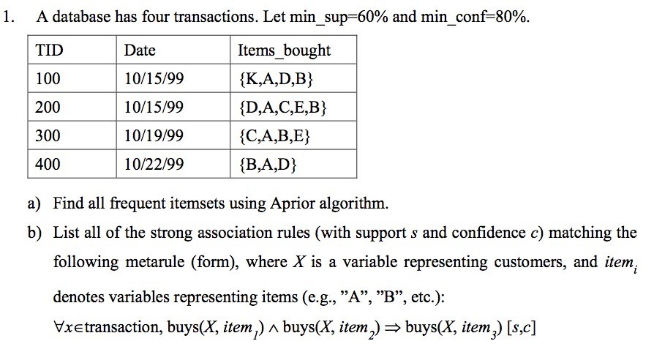
A.R.M. Exercise 1
Notes:
Set notation: “for all x that are elements of the transaction…”

Slide 29
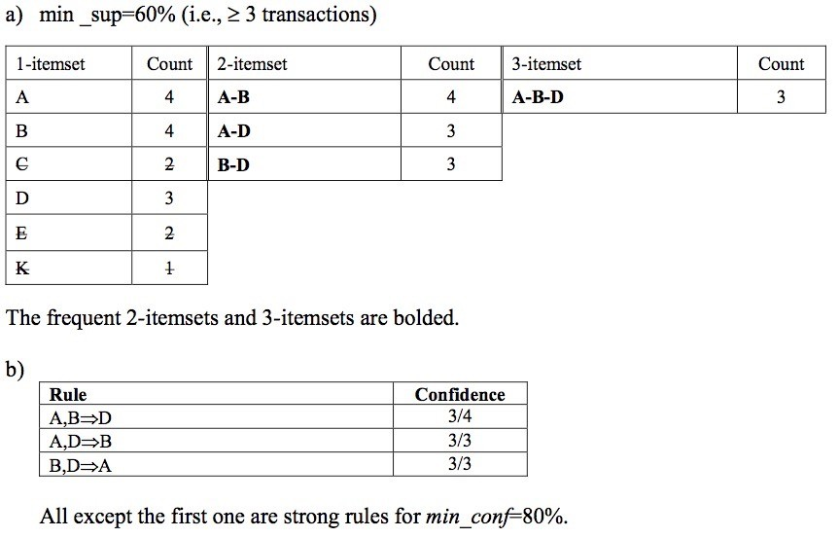
A.R.M. Solution 1

Slide 30
Cluster Analysis

Slide 31
Clustering
Automatically sorting data in groups of clusters
Raw Data
Algorithm

Slide 32
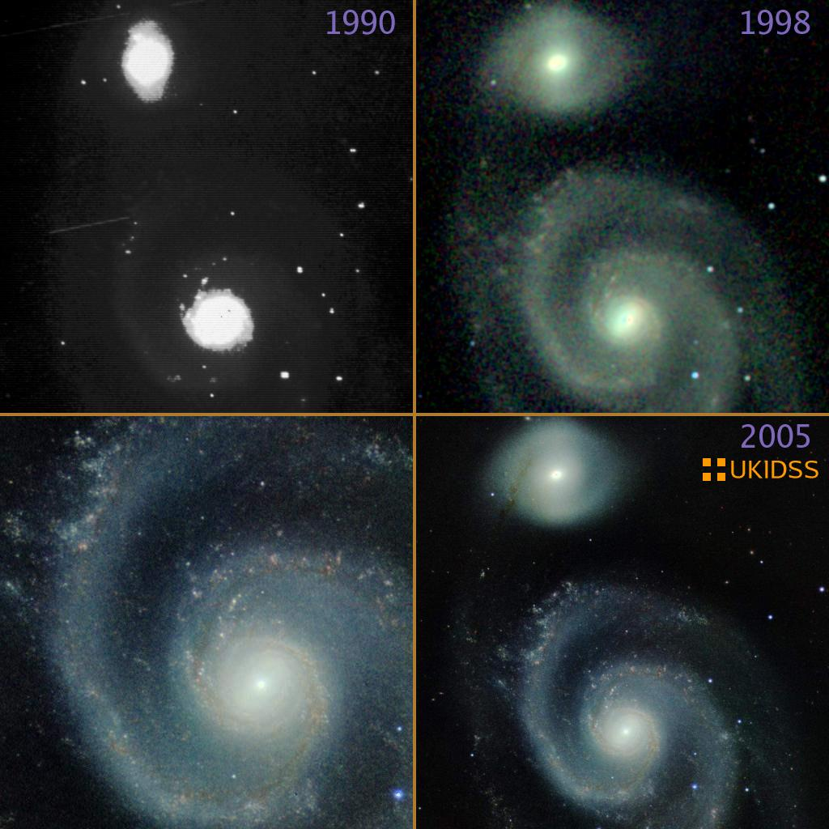
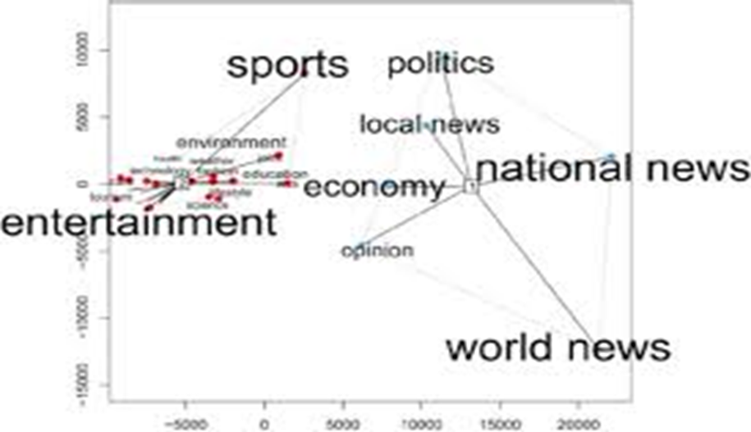
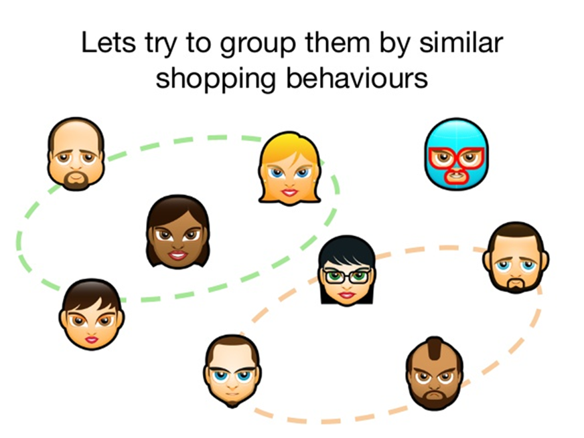



Clustering
Clustering is the process of automatically segregating dataset into different groups based on commonalities (similarities).
Applications in diverse domains
Notes:
Dimensionality reduction: just 1-dimension. Cluster labels.
Document clustering: group documents into similar topics. Summarize cluster groups, than reading through whole documents. Routing customer support incidents, online content sites, forensic investiaations..
Session grouping: in web analytics, clustering is helpful to understand clusters of clickstream patterns and discover different kinds of click stream profiles.
One cluster of customers: know what they want and redily proceed to checkout.
Another cluster: customers may spend time, read reviews, and then buy.

Slide 33
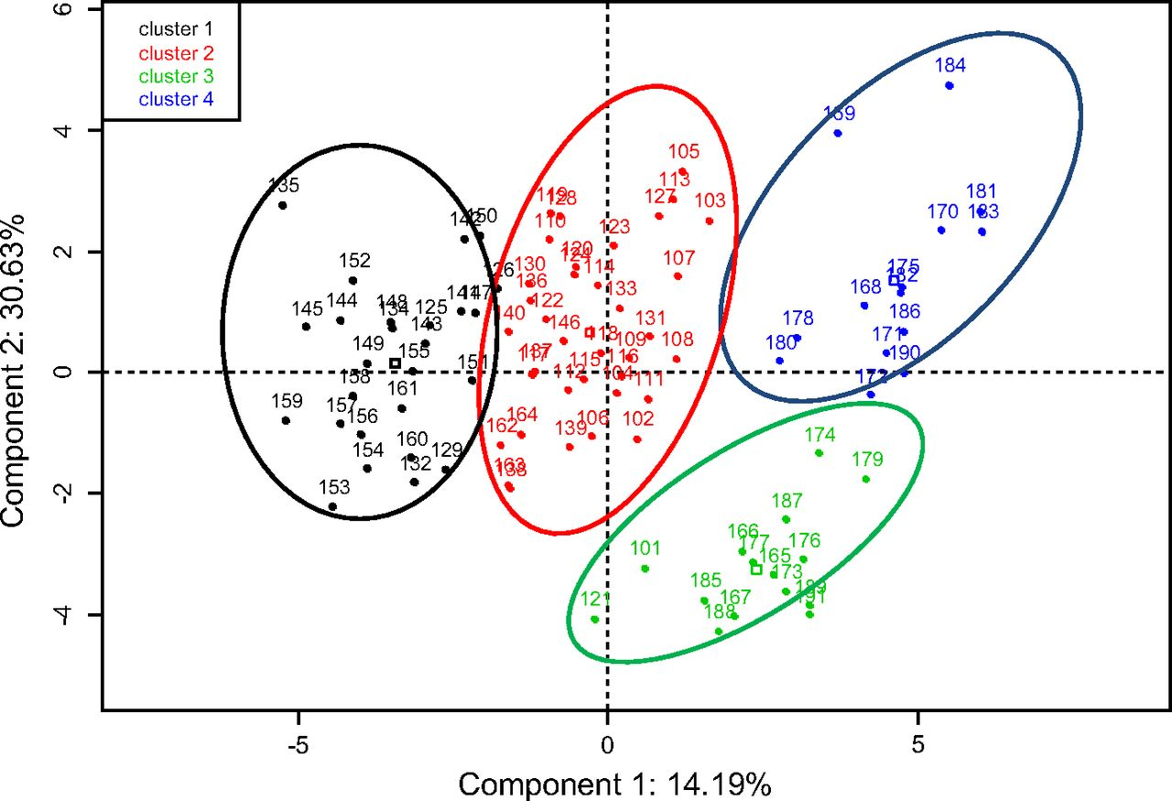
Cluster Analysis
Notes:
Algorithm driven by Euclidian distance measurements
Decision boundaries between clusters aren’t always intuitive
Key Metrics
K: the number of clusters you specify
Davies–Bouldin Index: avg. distance of cluster members to cluster center avg. distance b/t centroids of different clusters
Convergence Threshold: minimum amount of improvement needed to continue working on the problem
Max Iterations: stopping point to save computing resources

Slide 34
Overview
Cluster analysis (a.k.a., clustering) is the task of grouping a set of objects in such a way that objects in the same group (a.k.a., cluster) are more similar to each other than to those in other groups (clusters).
The “right” groupings are NOT known ahead of time. That is, they are not present in the data set.
Important Terms:
Intra-class Similarity = Closeness of cluster members.
Inter-class Similarity = Closeness of clusters.
Centroid = Center of a cluster.
Notes:
Data Type
Numeric
Popular Technique
K-Means

Slide 35
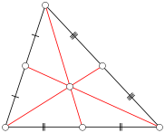
Terminology
Intra-class Similarity:
How strongly units in the same group resemble each other.
Greater similarity is better.
Inter-class Similarity:
How strongly units in different groups resemble each other.
Less similarity is better.
Centroid:
The center of a cluster calculated as the average position of all the points in all of the coordinate directions.
Notes:
Data Type
Numeric
Popular Technique
K-Means

Slide 36
Clustering Methods
Notes:
Many types of clustering method
Choice depends on computational overhead and complexity of problem “space”

Slide 37
Clustering Methods
Clustering
Fuzzy
Deterministic
Hierarchical
K-Means
K-Medoids
Partitioning
DBSCAN
Notes:
Fuzzy clustering: Instead of a definite association, this method assigns probabilities to an instance with respect to all clusters. Any instance will belong to all clusters, with different probabilities.
Centroid based: kmeans, k-medioids. Each customer cluster will have a central protype customer.
Density based: Dense regions where data points are concentrated separate by a lowe density region is categoriezed as a cluster. Low density region is just treated as noise. In this way, some data points may not be assigned to any cluster at all.
Hierarchical: Every point is a cluster, and will keep merging with neighboring clusters until one gaint cluster: agglomerative (opposite of this is divisive).
Model-based (not shown in the above): here the data points are assumed to belong to some distribution (gaussian, poisson) – each distribution which models a group of data points is a cluster. Paramters for each distribution are optimized to fit a group of data points. Mixuture of gaussians – is one such technique.

Slide 38
Partitioning Process
Choose # of clusters and randomly pick locations for centers.
Assign each observation to the cluster whose mean yields the least within-cluster sum of squares (i.e., the nearest center).
Recalculate centers as the arithmetic average of all the data points in the cluster.
Repeat steps 2 & 3 until convergence or max iterations threshold is reached.

Slide 39
K-Means vs. K-Medoids
Define “Average”:
The center of a cluster calculated as the average position of all the points in all of the coordinate directions.
“Average” has different mathematical definitions.
Mean: sum of values / count of values
Median: middle value in an ordered list of values
K-Means calculates mean positions from all cluster points as its average positions, called “centroids”.
K-Medoids selects data points closest to the median of all cluster points as its average positions, called “medoids”.

Slide 40
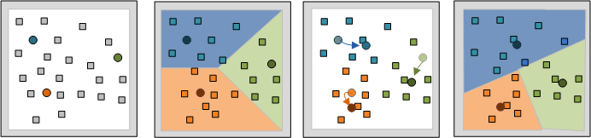
K-Means in Action
http://stanford.edu/class/ee103/visualizations/kmeans/kmeans.html
Notes:
Nearest measure is typically Euclidean distance. Other methods like Manhattan measure and Jaccard coefficient are also used.
Disadvantages: 1) Problem with k-means is it finds the local optimum but not global because centroids are initialized randomly. For a particular random initiation, it may or may not find the global best solution. One solution is to do multiple random initiations and choose the initiation with the best performance criterion.
2) Empty clusters (doesn’t exist for k-medoids) : current Sklearn implementation overcomes this, by assigning the centroid of the empty cluster to the farthest sample point.
3) Need to specify number of clusters.
4) Presence of outliers, clusters of all shapes… since centroid protoypte is used, k-means tends to find global clusters in the data set.
Evaluation criterion is SSE = Sum of squares errors within a cluster and or average sum of squares error for all the clusters.
Davies-Bouldin Index: takes care of both within cluster SSE, and also separation between clusters.
= ratio of Within cluster SSE/(Separation between clusters. The lower the index the better clustering.

Slide 41
K-Medoids in Action

Slide 42
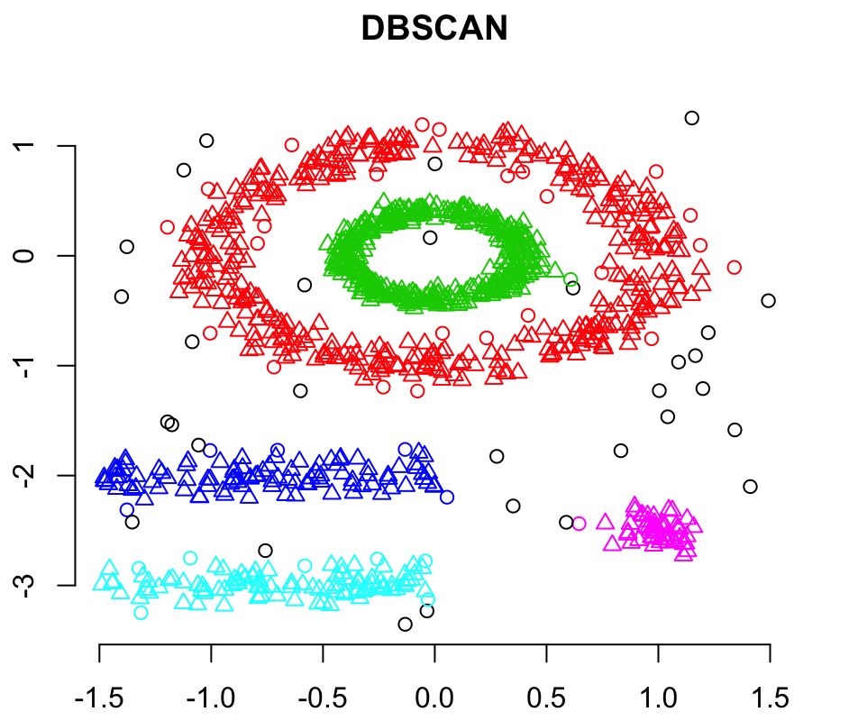
Density-Based Clustering
Calculates the density of all data points in a dataset based on a chosen radius (Ɛ) and a MinPoints parameter.
Then all high density spaces are categorized as separate clusters, surrounded by low density spaces which are just treated as noise.
Notes:
(DBSCAN) is a data clustering algorithm proposed by Martin Ester, Hans-Peter Kriegel, Jörg Sander and Xiaowei Xu in 1996. It is a density-based clustering algorithm: given a set of points in some space, it groups together points that are closely packed together (points with many nearby neighbors), marking as outliers points that lie alone in low-density regions (whose nearest neighbors are too far away). DBSCAN is one of the most common clustering algorithms and also most cited in scientific literature.
The DBSCAN algorithm can be abstracted into the following steps:
Find the ε (eps) neighbors of every point, and identify the core points with more than minPts neighbors.
Find the connected components of core points on the neighbor graph, ignoring all non-core points.
Assign each non-core point to a nearby cluster if the cluster is an ε (eps) neighbor, otherwise assign it to noise.
The advantages of DBSCAN are:
DBSCAN does not require one to specify the number of clusters in the data a priori, as opposed to k-means.
DBSCAN can find arbitrarily shaped clusters. It can even find a cluster completely surrounded by (but not connected to) a different cluster. Due to the MinPts parameter, the so-called single-link effect (different clusters being connected by a thin line of points) is reduced.
DBSCAN has a notion of noise, and is robust to outliers.
DBSCAN requires just two parameters and is mostly insensitive to the ordering of the points in the database. (However, points sitting on the edge of two different clusters might swap cluster membership if the ordering of the points is changed, and the cluster assignment is unique only up to isomorphism.)
DBSCAN is designed for use with databases that can accelerate region queries, e.g. using an R* tree.
The parameters minPts and ε can be set by a domain expert, if the data are well understood.

Slide 43
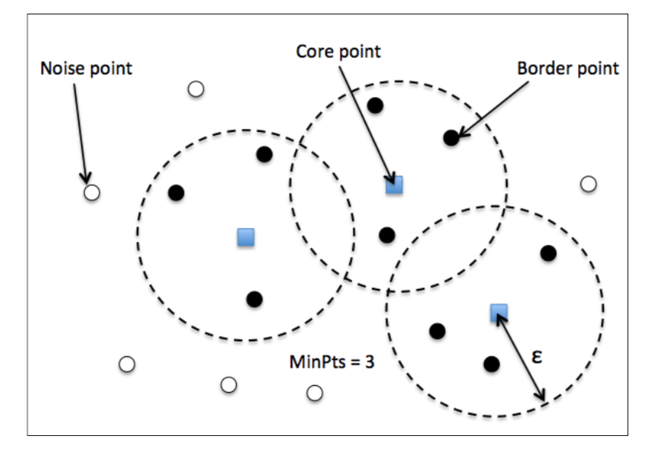
DBSCAN
Core point: A point is considered as core point, if at least a specified number (MinPoints) of neighbhoring points fall within Ɛ
Border Point: A point that has fewer neighbors than MinPoints within Ɛ
Noise Point: All other points
DBSCAN Algorithm
Form a separate cluster for each core point or a connected group of core points.
Assign each border point to the cluster of its corresponding core point.

Slide 44
Hierarchical Clustering
It treats each observation as a cluster
Identifies the two clusters that are closest, and merges them into one cluster
The process is repeated until all the clusters are merged. This is called Agglomerative clustering (Bottom-up approach)

Slide 45
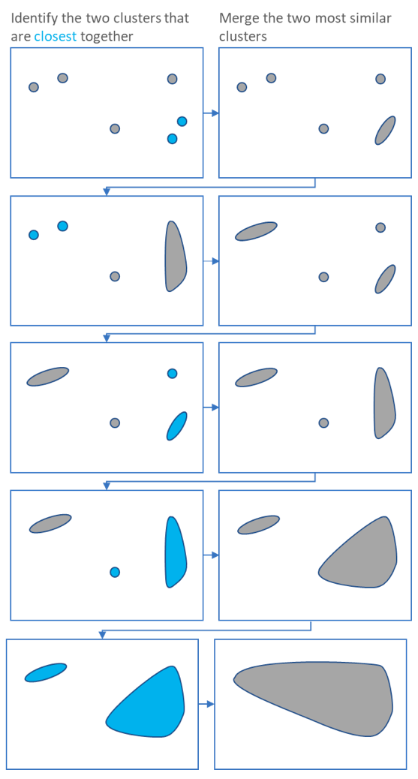
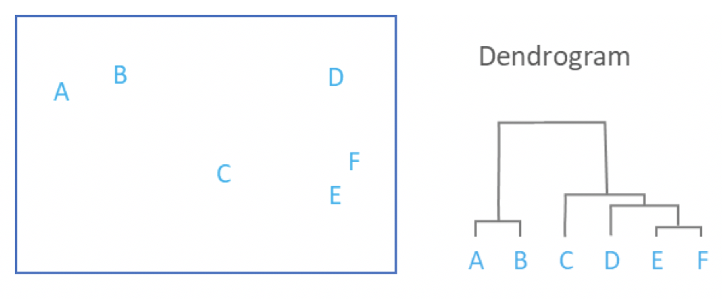
Hierarchical Clustering
Source: Displayr.com

Slide 46
Dimensionality Reduction

Slide 47
Dimensionality Reduction
Curse of Dimensionality
Data Science and ML problems generally involve thousands or even million features for each training instance
Having so many features can make training extremely slow, and may also lead to overfitting.
Some of the many features may not be important like in pixel data
Another problem with too many dimensions is in terms of data visualization. How many dimensions can we intuitively imagine or visualize???
Source: Aurelien Geron, Hands on ML

Slide 48
Dimensionality Reduction Techniques
Two main Approaches for dimensionality reduction
Projection
Principal Component Analysis (PCA)
Incremental PCA, Randomized PCA
Kernel PCA
Manifold Learning
Locally Linear Embedding (LLE)

Slide 49
Projection
For several real world datasets, instances are not uniformly spread over all the dimensions. They typically scatter close to a lower dimensional subspace of the original higher dimensional space.
Every training instance is then projected onto this lower dimensional subspace.

Slide 50
Principal Component Analysis
First an appropriate hyperplane (lower dimensional space) that lies closest to the data is identified. This will be the primary axis which preserves the maximum amount of variance.
PCA will also find a second axis orthogonal to the first one, that accounts for the largest amount of remaining variance. This process can be repeated to find remaining Principal components (as many axes as dimensions)
Every training instance is then projected onto the hyperplane defined by the principal components.
Notes:
Here z1 is for each of the different choices of hyperplane.

Slide 51
Identifying the appropriate dimensions (or principal components)
Explained variance ratio: Proportion of the variance in the data that lies along the axis of each principal component.

Slide 52
Other Projection Algorithms
Incremental PCA
Implementation of general PCA algorithm requires the whole dataset to reside in memory
For large datasets or to apply PCA on the stream, Incremental PCA can be used, where training data is split into batches and each batch is passed to the algorithm incrementally.
Randomized PCA
This uses a stochastic algorithm that rapidly finds an approximation to the first ‘p’ principal components. Faster than general PCA.
Kernel PCA
Performs non-linear projections for dimensionality reduction
Good at preserving clusters of instances even after projection
Notes:
Kernel PCA similar to

Slide 53
Manifold Learning
Manifold: Shape that can be easily bent and twisted into a higher dimensional space.
Manifold hypothesis: Most real-world high dimensional datasets lie close to lower dimensional manifold
Original Swiss Roll Dataset
Projection
Manifold

Slide 54
Locally Linear Embedding (LLE)
Powerful non-linear dimensionality reduction technique based on Manifold Learning
First identifies each instance’s closest neighbors and reconstructs the instance as a linear function of its closest neighbors.
Algorithm then looks for a low-dimensional representation of the data set, where the relationships between the instance and its neighbors are preserved.
Source: Aurelien Geron, Hands on ML

Slide 55
QUESTIONS?

